Slide 1
Authentication Tutorial

Slide 2
Authentication over REST
Motivation: one authentication strategy for all user interfaces.
We have already seen that a Grails-based REST controller supports multiple user interfaces.
Since we have already set up our controllers to communicate using REST calls, let’s add authentication to this existing infrastructure.

Slide 3
Browser
GET /api/someResource
REST API
HTTP 401 UNAUTHORIZED
Redirect to Login
POST /api/login
Validate Login Info
Generate/Save Token
{“token”: “ahdshjk172789…”}
Save Token
GET /api/someResource
{“token”: “ahdshjk172789…”}
Validate Token
JSON response
Notes:
Adapted from websequencediagrams.com

Slide 4
Authentication over REST
Summary
User attempts to access API resource requiring credentials
Client is redirected to login form
User enters credentials, UI sends to server using POST
If valid, server generates and responds with token
Client stores the token internally
When user or client makes another API call, token will be sent
Server uses the token for validation and permissions checking
Server responds with requested resource or refusal code

Slide 5
REST Authentication in Grails
Grails applications can use the spring-security-rest plugin to help manage the process.
Documentation:
http://alvarosanchez.github.io/grails-spring-security-rest/latest/docs/index.html
There are several basic tutorials available including this pair:
http://sergiodelamo.es/how-to-use-spring-security-core-to-secure-you-grails-3-app/
http://sergiodelamo.es/how-to-secure-your-grails-3-api-with-spring-security-rest-for-grails/
Fully functional example available on GitHub
https://github.com/ethamajin/grails3-example

Slide 6
REST Authentication in Grails
For the seriously interested, you should read through the resources mentioned in the previous slide.
It is recommended to play with a separate project while you experiment with authentication. After you understand the basic structure, you can start to integrate it into your project.

Slide 7
REST Authentication in Grails
The spring-security-rest plugin will create three domain classes by default: User, Role, and UserRole.
User will probably replace an existing class you had in mind for your project. Don’t worry, you are free to modify this generated User class with your own features.
The remainder of this tutorial will focus on the example project.

Slide 8
Grails / REST / React Example Project
The example project was forked from https://github.com/atapin/grails3-example
We will be using this example project for the next tutorial as well.
Like our earlier example project, it implements a RESTful web server and a React-based UI. The code is organized almost identically.

Slide 9
Example – Domain Classes
The domain classes in this example were generated automatically by calling:
grails s2-quickstart grails3.exampleUser Role
Important Features:
Users have a username and password
Roles have an authority
UserRoles are used to assign a Role to a User

Slide 10
Example – Domain Classes
File: ./init/BootStrap
Initialization of an example Role, User and UserRole. You can test this account when you run the application.
Authority values are used to control access to Controllers, and Controller Methods using special annotations.
import grails3.example.Role import grails3.example.User import grails3.example.UserRole class BootStrap { def init = { servletContext -> def role = new Role(authority: 'ROLE_USER').save() def user = new User(username: 'test', password: '2212').save() UserRole.create(user, role, true) } def destroy = { } }

Slide 11
Example – Controller Classes
Two controller classes: SearchController and UserController.
Each controller has an associated Service Class in ./services.
Service classes contain logic that could otherwise be found in the controller class, make sense to separate as added functionality. For example, helper functions to make external API calls are appropriate for service classes.

Slide 12
Example – Controller Classes
File: SearchController.groovy
@Secured(['ROLE_USER']) class SearchController { static responseFormats = ['json'] def searchService def search(String q) { log.debug("Searching by query = ${q}...") def result = searchService.search(q.trim()) respond result }
…
The @Secured annotation is a Spring Security annotation indicating that only Users with the authority ROLE_USER may use this controller.
Secured annotations make it easy to control which users have access to which controllers. You can use these annotations at the class level or at the method level for finer-detail control.

Slide 13
Example – Controller Classes
File: SearchController.groovy
@Secured(['ROLE_USER']) class SearchController { static responseFormats = ['json'] def searchService def search(String q) { log.debug("Searching by query = ${q}...") def result = searchService.search(q.trim()) respond result }
…
def searchService loads in an instance of the service class. It’s just a normal Java-like class that sets up an API call to Twitter. We will see this in the next tutorial, but feel free to explore in the meantime.
Notice the use of a parameter to the search method. We could equivalently use params.q instead of specifying the parameter directly.
Otherwise, this is just a typical controller.

Slide 14
Example – Controller Classes
File: UserController.groovy
class UserController { static responseFormats = ['json'] def userService def signUp(@RequestParameter('username') String username,
@RequestParameter('password') String password) { log.debug("Signing up a new user: ${username}:[******]") def user = userService.signUp(username, password) def payload = [username: user.username] as Object respond payload, status: HttpStatus.CREATED }
Similar to the last example, UserController also uses a service class.
The signUp method demonstrates yet another syntax to accepting parameters from URLs.
This is also equivalent to taking in values from params.username and params.password.

Slide 15
Example – Controller Classes
A login controller was automatically defined by
spring-security-rest.
We can test it by making an API call.

Slide 16
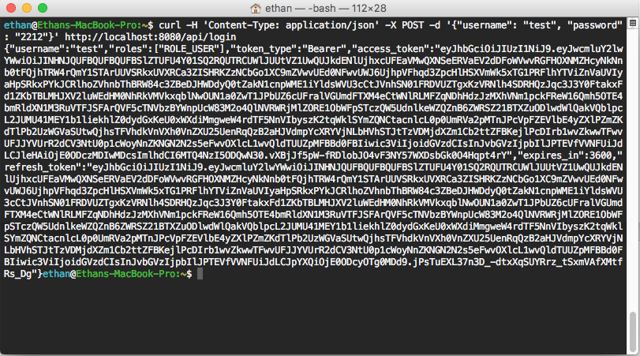
Testing the login API
curl -H 'Content-Type: application/json' -X POST -d '{"username": "test", "password": "2212"}' http://localhost:8080/api/login

Slide 17
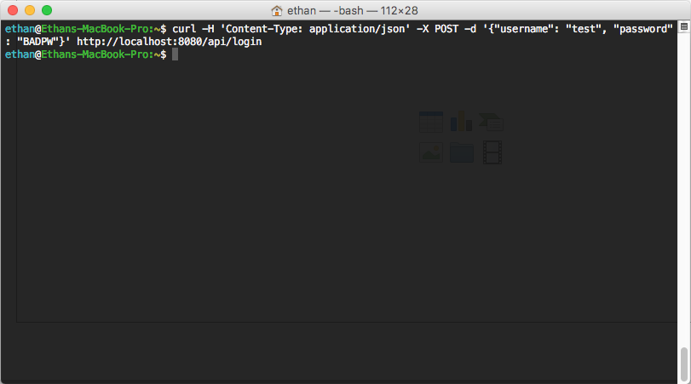
Testing the login API
curl -H 'Content-Type: application/json' -X POST -d '{"username": "test", "password": ”BADPW"}' http://localhost:8080/api/login

Slide 18
Testing the login API
The response from the first request was successful.
It contained:
The username
The user’s authorized roles
An access token (expire, within a reasonable session duration)
A refresh token (used to request new access tokent)
For now, all we need to know is that Spring Security is managing tokens for us, and we can use them transparently in our application.

Slide 19
Testing the login API
Questions:
How secure is this system?
Can you identify any possible flaws?
Tell Grails to run in HTTPS mode by modifying the run configuration to grails run-app -https

Slide 20
Example – React Views
So far, we have configured SearchController to only respond to requests coming from authenticated users with the ROLE_USER authority.
We then tested the login API from the command line.
Now let’s see how to log in from a React UI.

Slide 21
Example – React Views
File: signin.js
signIn(e) { e.preventDefault(); console.log("Signing in...", this.form.data()); fetch("/api/login", { method: 'POST', headers: { 'Accept': 'application/json', 'Content-Type': 'application/json' }, body: JSON.stringify(this.form.data()) }) .then(checkStatus) .then(this.success.bind(this)) .catch(this.fail.bind(this)) }
This React component is responsible for making the API call to our login controller.
The username and password are being wrapped up into a JSON object and sent as the POST call body.
The request is then identical to the one we sent using the command line.

Slide 22
Example – React Views
File: signin.js
signIn(e) { e.preventDefault(); console.log("Signing in...", this.form.data()); fetch("/api/login", { method: 'POST', headers: { 'Accept': 'application/json', 'Content-Type': 'application/json' }, body: JSON.stringify(this.form.data()) }) .then(checkStatus) .then(this.success.bind(this)) .catch(this.fail.bind(this)) }
The .then() methods will execute once the server responds.
checkStatus is another function in the same class that interprets the response code.
If the response was successful, then the second .then will bind the JSON response – exactly what we saw on the command line – to an internal storage mechanism so that the tokens are available in the session. See auth.js for details.

Slide 23
Example – React Views
File: search.js
search(e) { e.preventDefault(); console.log("Searching..."); let token = this.state.auth.access_token; let query =
ReactDOM.findDOMNode(this.refs.query).value.trim();
this.setState({inProgress: true}); fetch("/api/search?q=" + query , { headers: { 'Authorization': 'Bearer ' + token } }) .then(checkStatus) .then(this.success) .catch(this.fail) }
This function is called when the search form is submitted.
This class is initialized with the token as a state variable, and simply includes it as part of the API call header.
Recall the implementation of SearchController on the client side.
Aside from the @Secured annotation, our authorization protocol is almost entirely transparent!
@Secured(['ROLE_USER']) class SearchController { static responseFormats = ['json'] def searchService def search(String q) { log.debug("Searching by query = ${q}...") def result = searchService.search(q.trim()) respond result }
…

Slide 24
Example – React Views
The remainder of the UI components in the example code are outside the scope of this tutorial.
For teams interested in using React, I recommend the following tutorial for more advanced features including those used in the example code. It assumes just the basic knowledge you should have from our tutorial on React.
https://css-tricks.com/learning-react-router/

Slide 25
Example – Information from Tokens
To control permissions, we may want to extract information about the current user given an authenticated REST call.
For example, we might use the username field to determine whether access should be granted to a secret event group.
To do this, we can use a built-in service class called SpringSecurityService.

Slide 26
Example – Information from Tokens
File: SearchController.groovy
@Secured(['ROLE_USER']) class SearchController { static responseFormats = ['json'] def searchService def springSecurityService def search(String q) { // Gets the current user name - can be used to control permissions def info = springSecurityService.currentUser.username log.debug("Searching by query = ${q}...") def result = searchService.search(q.trim()) respond result }
Adding a reference called springSecurityService enables the extraction of user information from an authenticated API call.
Again, note the transparancy of this approach. We are never actually dealing with permission levels or tokens manually – we can set up a very simple system to do this for us!

Slide 27
Notes on Security
We have only scratched the surface of securing our Grails application.
This example provides some basic security, but it is a much more complex issue than we can cover.
I strongly recommend reading all the resources linked in these slides.

Slide 28
Notes on Security
For your projects, basic security and authentication is important.
However, I don’t expect anyone to become a security expert in six weeks – and our expectations in evaluations will reflect this.
Where appropriate, though, you should attempt to implement a model similar to the example.
You can even use this project as a starter.

Slide 29
Your Tutorial Task
Submission on OWL Due Friday March 10th at 11:55pm
Go to https://haveibeenpwned.com/
Enter some of your accounts.
Have you been pwned?
Submit the list of breaches you were pwned in.
Get 2.5% of your grade – that easy.

Slide 30
Enjoy Reading Week!

